Slide 1
#35: Open Quantum systems and master equation implementation through reinforcement learning
Mentor: Abhijit Mitra
Mentees:
Alberto Maldonado
Shivam Sawarn
Vaibhaw Kumar
Kavitha Yogaraj
Gayathree M. Vinod

Slide 2
Description
The quantum open systems master equation has the Schrödinger portion of the equation plus the non-unitary thermal dissipation part. The objective here is to come up with an implementation where the Schrödinger part is solved by unitary operations, but the other piece is learnt through an agent acting in the open environment through reinforcement learning or RL.

Slide 3
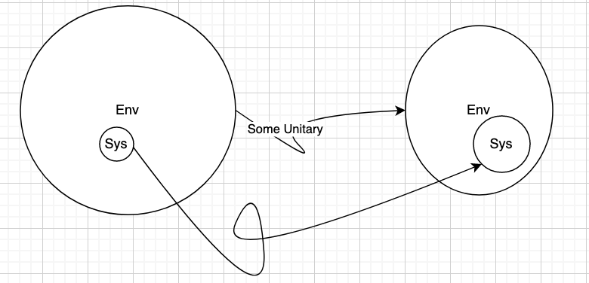
Open Quantum Systems
An open quantum system is a quantum-mechanical system that interacts with an external quantum system, which is known as the environment or a bath. In general, these interactions significantly change the dynamics of the system such that the information contained in the system is lost to its environment.
Because no quantum system is completely isolated from its surroundings, it is important to develop a theoretical framework for treating these interactions in order to obtain an accurate understanding of quantum systems.
What does unitary mean in quantum mechanics? A linear operator whose inverse is its adjoint is called unitary. These operators can be thought of as generalizations of complex numbers whose absolute value is 1.
How does the Evolution of the sys from one to another, without referring to an env? The interactions will not be unitary

Slide 4
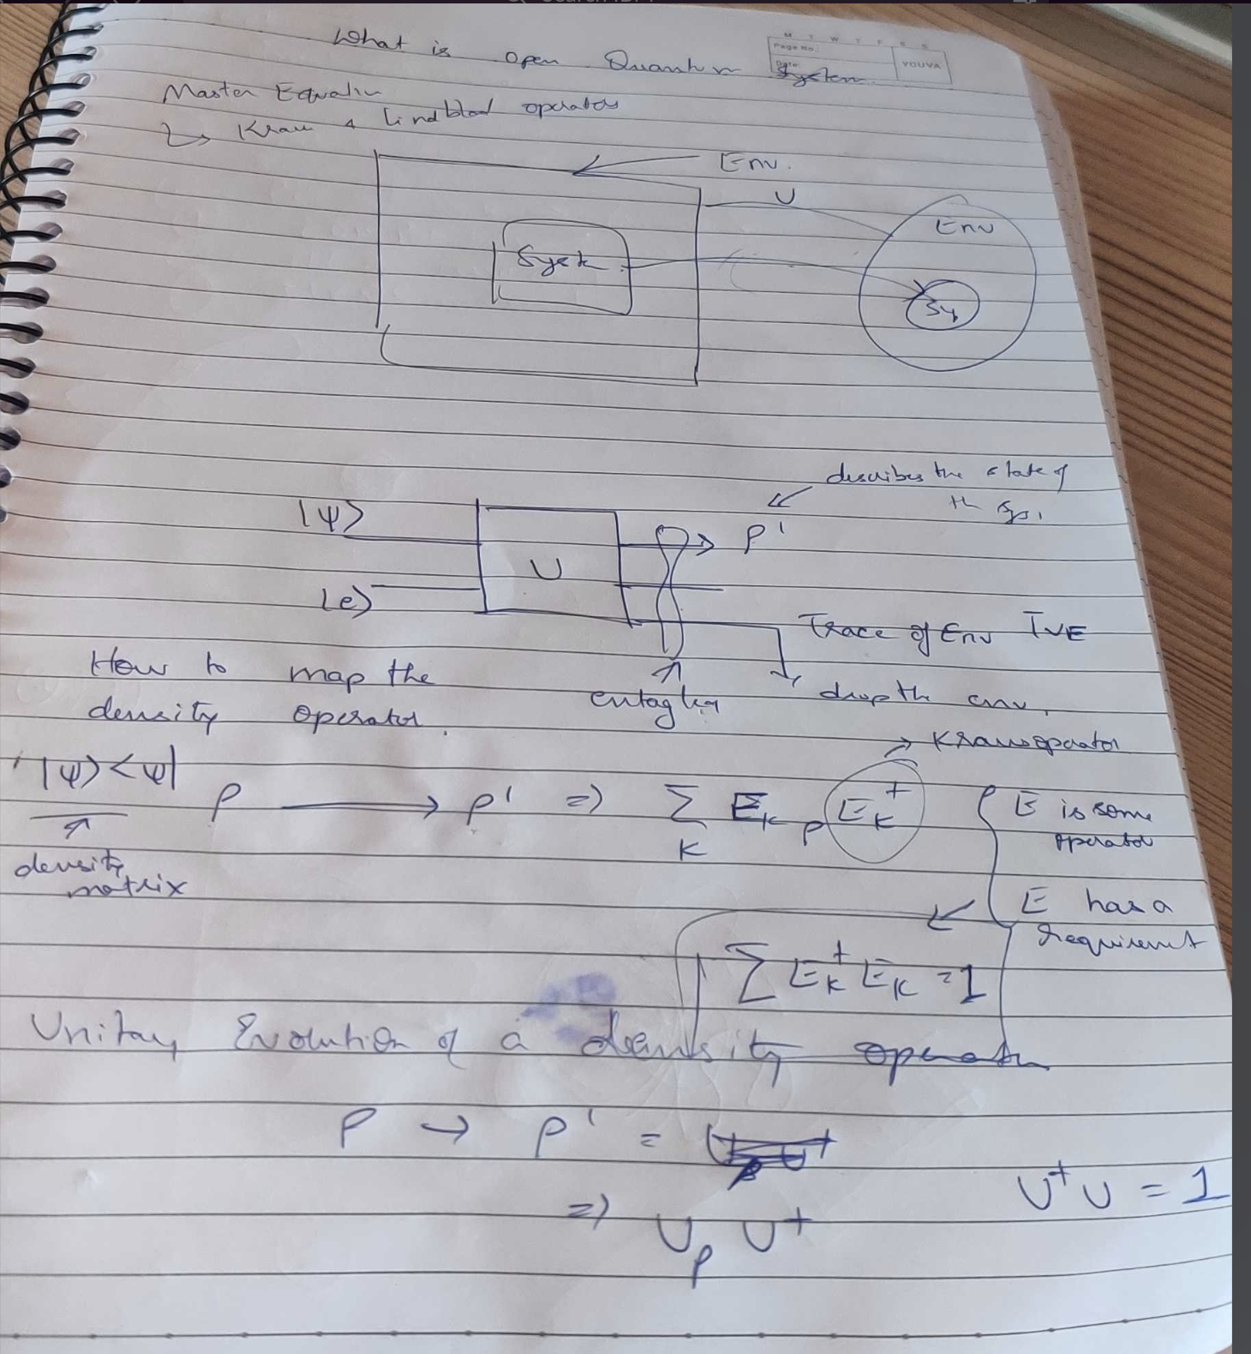
Open Quantum Systems
What does unitary mean in quantum mechanics?A linear operator whose inverse is its adjoint is called unitary. These operators can be thought of as generalizations of complex numbers whose absolue value is 1.
How does the Evolution of the sys from one to another, without referring to an env? The interactions will not be unitary

Slide 5
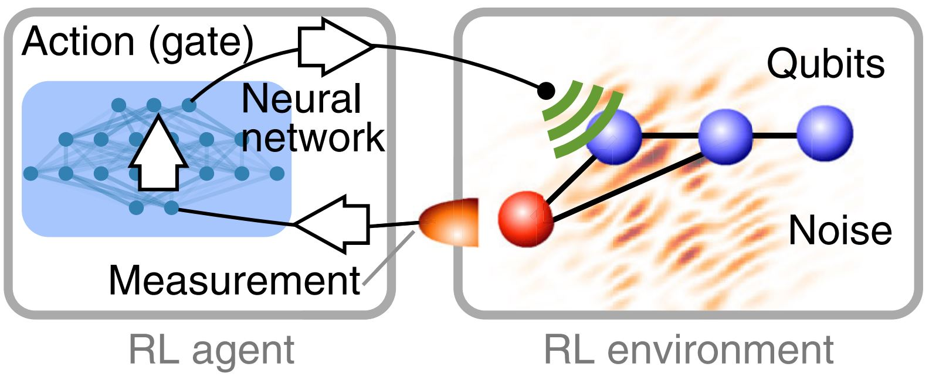
Reinforcement learning for quantum error correction
Conceptually, our approach aims to control a quantum system using a classical neural network.
To avoid confusion, we emphasize that our approach is distinct from future “quantum machine learning” devices, where even the network will be quantum
Quantum feedback is used for learning strategies to help build a fully autonomous, human-guidance-free approach for discovering quantum-error-correction (QEC) strategies
Paper’s goal is to have a neural network which can be employed in an experiment, receiving measurement results and selecting suitable subsequent gate operations conditioned on these results.
However, in our two-stage learning approach, we do not directly train this neural network from scratch. Rather, we first employ reinforcement learning to train an auxiliary network that has full knowledge of the simulated quantum evolution.
Fösel T, Tighineanu P, Weiss T and Marquardt F 2018 Reinforcement learning with neural networks for quantum feedback Phys. Rev. X 8 31084

Slide 6
This paper’s success
Two-stage learning with a RL-trained network receiving maximum input acting as a teacher for a second network. (where is two stage leanring?)
And a measure of the recoverable quantum information hidden inside a collection of qubits being used as a reward. (are we using this as the reward?)

Slide 7

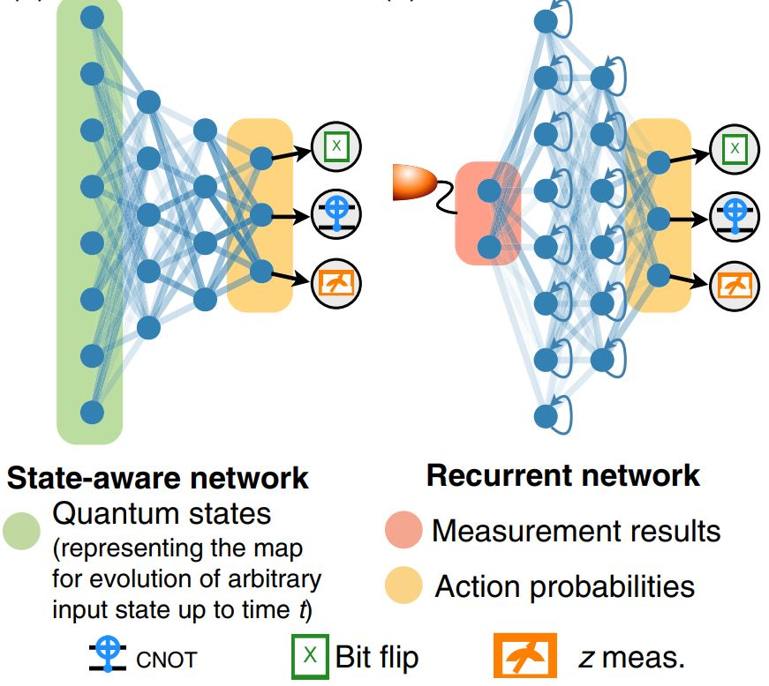
A two-stage learning
A two-stage learning:
A fully state-aware network – used as a teacher for the second network.
This first network is to be trained.
Supervised training for the second network.
Objective: to maximize the overlap between the initial and final states for any logical qubit state.
‘Recoverable Quantum Information’ – the reward.
Fösel T, Tighineanu P, Weiss T and Marquardt F 2018 Reinforcement learning with neural networks for quantum feedback Phys. Rev. X 8 31084

Slide 8
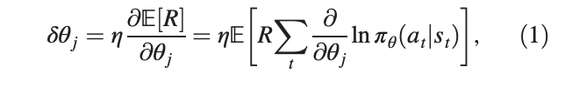
To-do – Fully Observed Env
The objective is to maximize the expected return R, i.e., a sum of rewards.
To find an optimal set of actions (in our case, quantum gates and measurements) that an agent can perform in response to the changing state of an environment (here, the quantum memory).
Use Policy Gradient rule to reinforce https://towardsdatascience.com/policy-gradients-in-reinforcement-learning-explained-ecec7df94245#:~:text=Policy%20gradient%20update%20rule.,%E2%88%87_%CE%B8%20J(%CE%B8).
with η the learning rate parameter and E the expectation value over all gate sequences and measurement outcomes
Equation (1) provides the standard recipe for a fully observed environment. T
Partially Observed Environment
The observations contain partial information on the actual state of the environment.

Slide 9
REINFORCEMENT LEARNING APPROACH TO QUANTUM MEMORY
We start by storing an arbitrary quantum state αj0i þ βj1i inside one physical qubit. The goal is to be able to retrieve this state with optimum fidelity after a given time span.
Importantly, the network must react and adapt its strategy to the binary measurement results, providing real-time quantum feedback. (What is quantum feedback here?)
As known from other RL applications (like board games [15]), it helps to provide as much information as possible to the network. In our case, this could mean providing the multiqubit quantum state at each time step.
we train two different networks in succession [Figs. 2(a) and 2(b)]: The first network is fully state aware. Later on, we use it as a teacher for the second network, which essentially gets only the measurement results as an input

Slide 10
Objectives:
Replicate the code in the paper using OpenAI Gym and Qiskit.
Extend this application to describe the non-unitary part of the master equation through RL.
Progress:
Learning some simple instances of using OpenAI Gym and Qiskit for RL.
Exploring more details of open quantum systems.

Slide 11

References
Fösel T, Tighineanu P, Weiss T and Marquardt F 2018 Reinforcement learning with neural networks for quantum feedback Phys. Rev. X 8 31084

Slide 12
PHD – First Problem
Read VFA papers shared by sir

